Slide 1




Data Exploration and Preparation
Session1
Prepared by: Eman Raslan

Slide 2
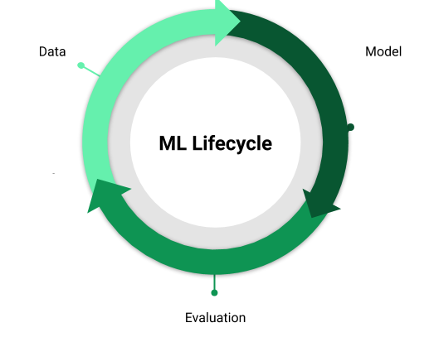
Machine Learning Life Cycle
Define Project Objectives
Data Acquisition
Machine learning Model
Train
Data Preparation
Data Exploration
Evaluate
Notes:
Machine learning is a method of data analysis that automates analytical model building.
It is a branch of artificial intelligence based on the idea that systems can learn from data, identify patterns and make decisions with minimal human intervention.

Slide 3
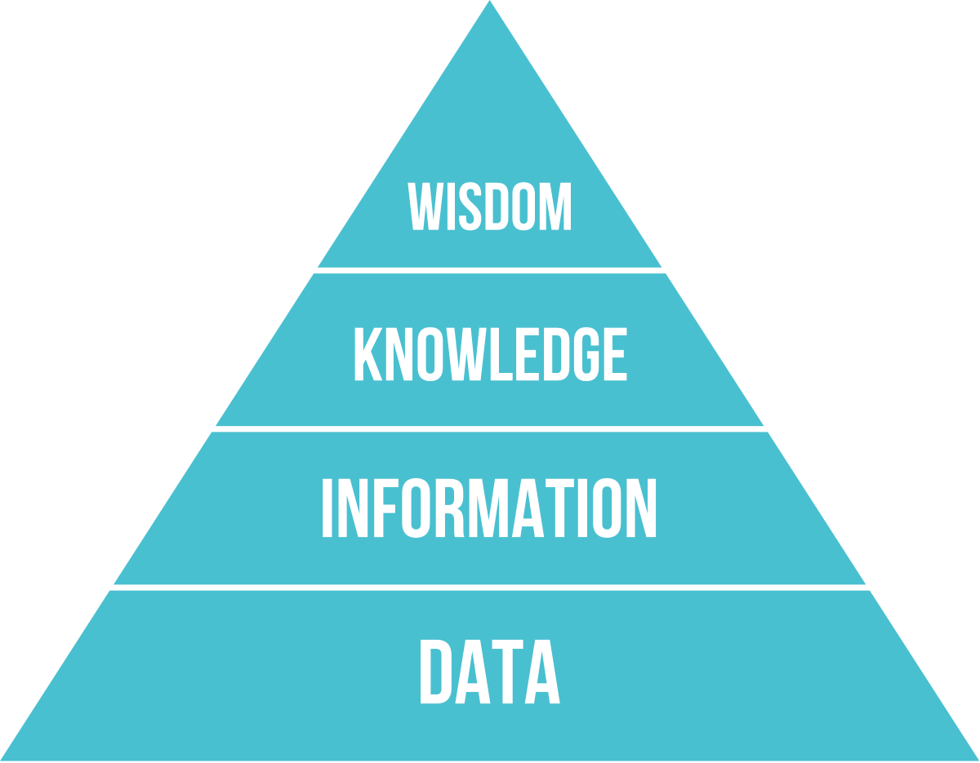

Slide 4
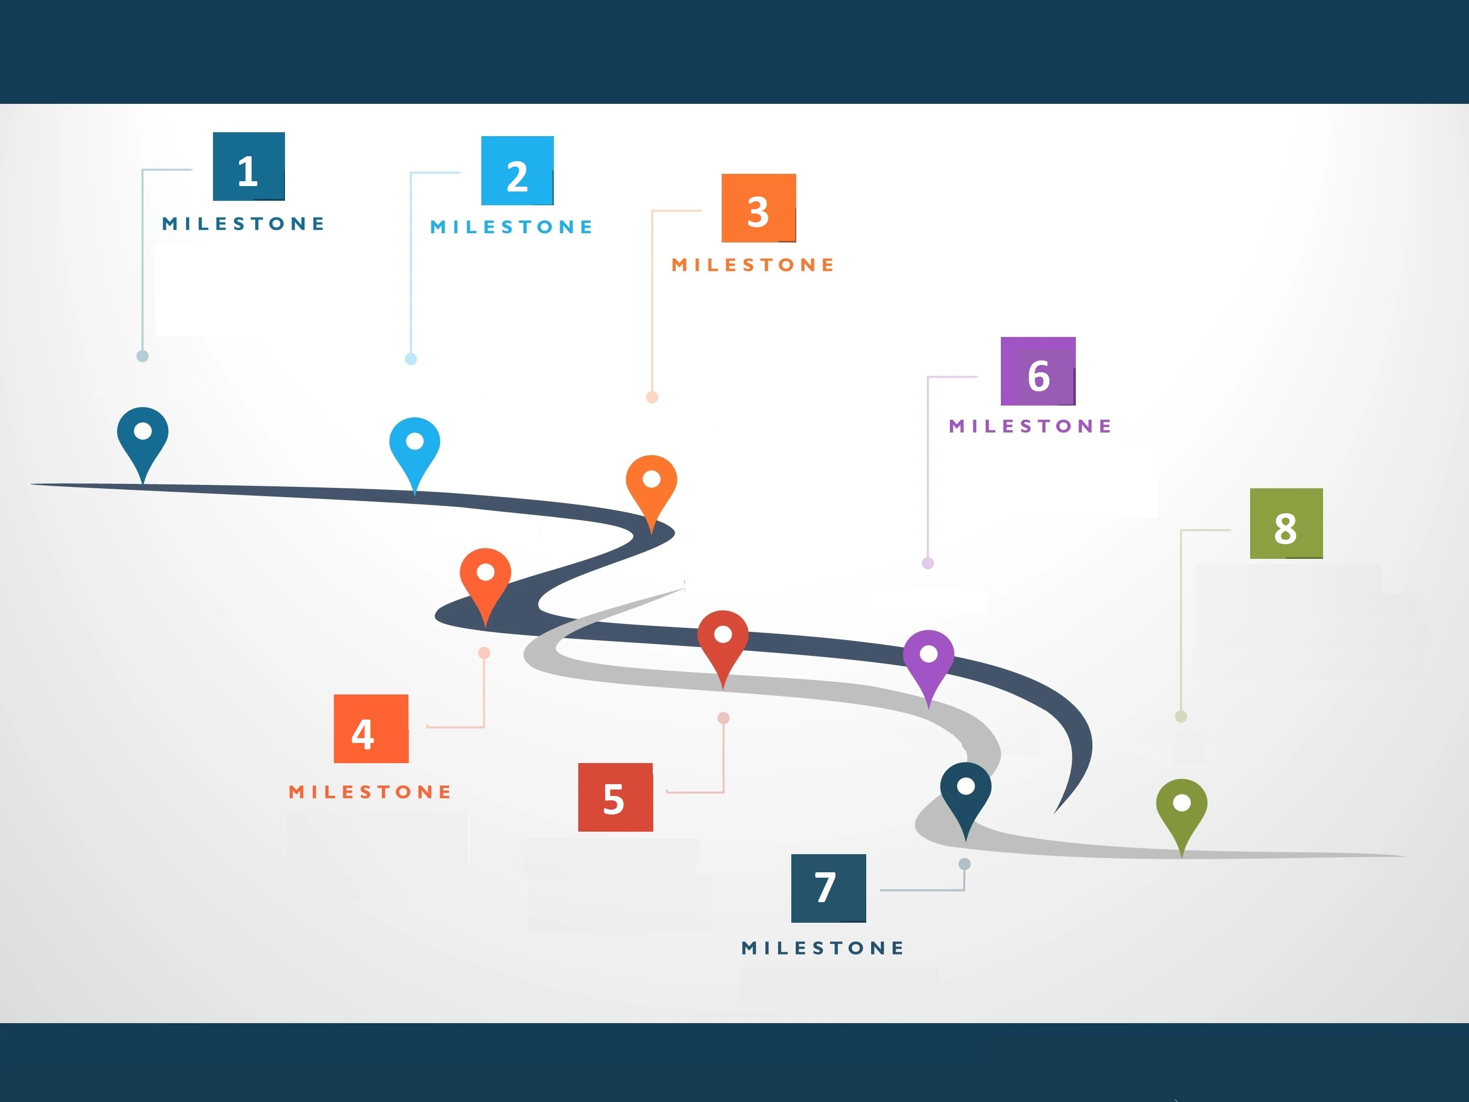
Data Exploration & Preparation RoadMap
Introduction to Data Exploration with CSV, Xml, Json, XSD, XSLT, and ARFF files.
Learn basics about REST services invocation, and how to get data from Web, using crawling techniques (with selenium)
Use a SQL client to query a RDBMS PostgreSQL database.
Dealing with data incorrectness like NA values.
Discover how to merge all the data they have gathered and demonstrate data visualization.
Practical Work, Quiz 1 & Exam 1
Practical Work, Quiz 2 & Exam 2
Data Exploration
Automation with ETL
Automatizing the pipeline with Talend ETL

Slide 5
Data Exploration and Preparation
Is the first step of the machine learning life cycle.
It is one of the most important steps of the life cycle.
In this step, we need to identify the different data sources, as data can be collected from various sources such as files, database, or internet.
First part includes the below tasks:
Identify various data sources
Collect data
Integrate the data obtained from different sources
By performing the above task, we get a coherent set of data, also called as a dataset.
The quantity and quality of the collected data will determine the efficiency of the output. The more will be the data, the more accurate will be the prediction.
The goal of this step is to identify and obtain all data-related problems (Data in the real world are “dirty”).
In real-world applications, collected data may have various issues, including:
Missing Values
Duplicate data
Invalid/Noise data
Notes:
It is not necessary that data we have collected is always of our use as some of the data may not be useful.
Data is often gathered in large, unstructured volumes from various sources and data analysts must first understand and develop a comprehensive view of the data before extracting relevant data for further analysis.
Helping to select the right tool for preprocessing and analysis.
Data Preparation allows you to identify unusual cases and invalid cases, variables, and data values in your active dataset, and prepare data for modeling.
Refers to the initial step in data analysis in which data analysts use data visualization and statistical techniques to describe dataset characterizations in order to better understand the nature of the data.

Slide 6
Data Exploration
Discover the different formats of data
Extract data from Relational Databases, CSV files, XML, JSON, ARFF, and Web
Data visualization
Be familiar with Orange.

Slide 7
Data Preparation
Dataset Integration.
Deal with missing values.
Know how to use an ETL to represent a data pipeline.
Be familiar with Talend Studio.

Slide 8
Course Schedule
Location | Objective | Date

Slide 9
Session 1 Contents
Introduction
CSV
XML
JSON
ARFF
Homework
XSD
XSLT
Orange DataMining

Slide 10
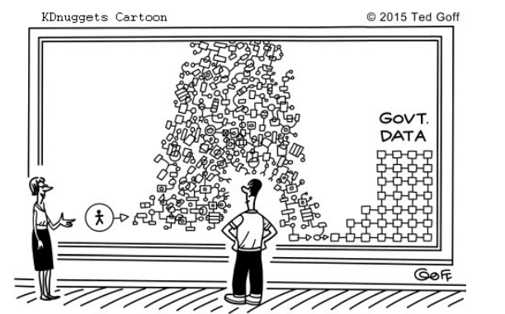
Before trying anything, you should know your data!

Slide 11
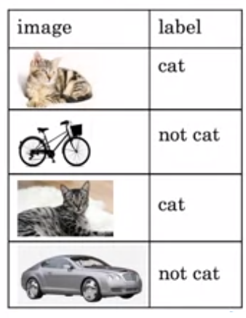
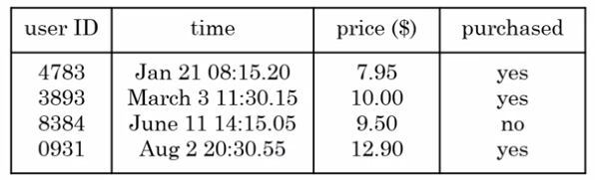
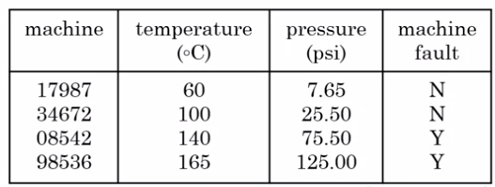
Data
Garbage In, Garbage Out
The lifeblood of machine learning is data.
Without data, we have nothing to train our machines with.
“It’s All About The Data!”

Slide 12
Variable
A variable is any characteristics, number, or quantity that can be measured or counted.
Age, sex, business income and expenses, country of birth, capital expenditure, class grades, eye color and vehicle type are examples of variables.

Slide 13
Independent and Dependent variable
The independent variable (feature) is the cause. Its value is independent of other variables in your study.
The dependent variable (target) is the effect. Its value depends on changes in the independent variable.
Notes:
Having a good understanding of the different data types, also called measurement scales, is a crucial prerequisite for doing Exploratory Data Analysis (EDA), since you can use certain statistical measurements only for specific data types.
You also need to know which data type you are dealing with to choose the right visualization method. Think of data types as a way to categorize different types of variables. We will discuss the main types of variables and look at an example for each. We will sometimes refer to them as measurement scales.

Slide 14
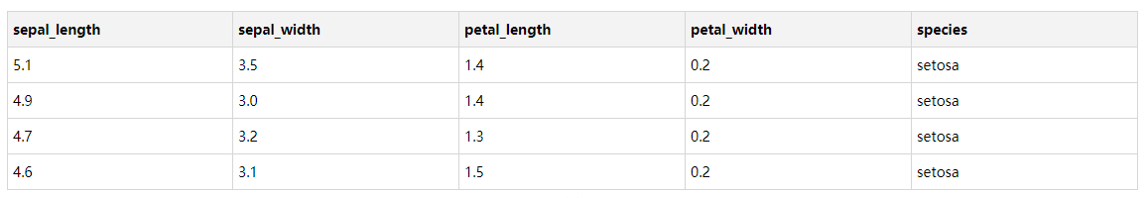

IRIS Dataset

Slide 15
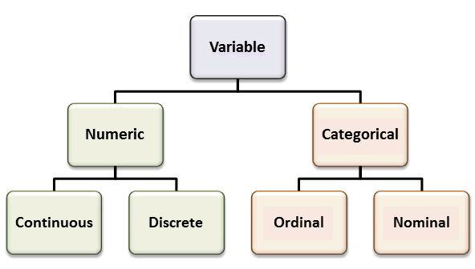
Variable Data Types
Quantitative
Qualitative

Slide 16
Data File Formats
CSV
XML
XSD
XSLT
Json
ARFF
SQL

Slide 17

Discover CSV

Slide 18
CSV
CSV stands for “Comma-Separated Values".
CSV is a simple file format used to store tabular data, such as a spreadsheet or database.
There may be an optional header line appearing as the first line of the file with the same format as normal record lines.
The header contains names corresponding to the fields in the file.
Also, it should contain the same number of fields as the records in the rest of the file.
Each line of the file is a data record.
All records should have the same number of fields, in the same order.
Each record consists of one or more fields, separated by commas.
CSV file with the extension (.csv).
If the fields of data in your CSV file contain commas, you can protect them by enclosing those data fields in double quotes (").
Notes:
Save excel sheet as csv

Slide 19
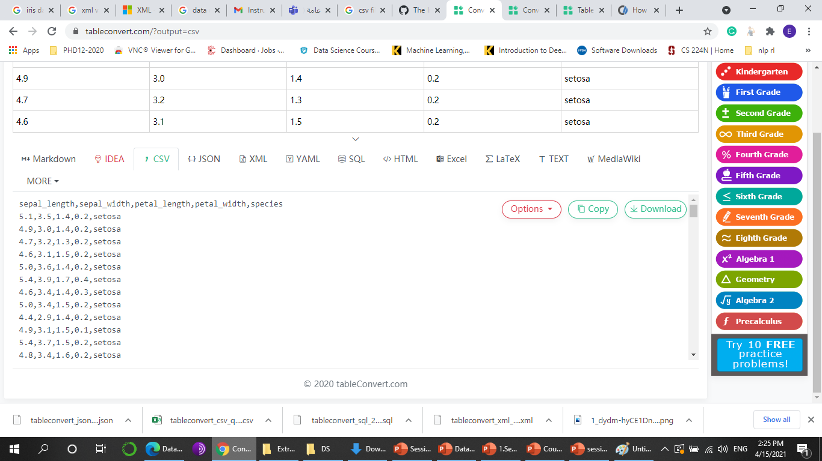
CSV Example

Slide 20
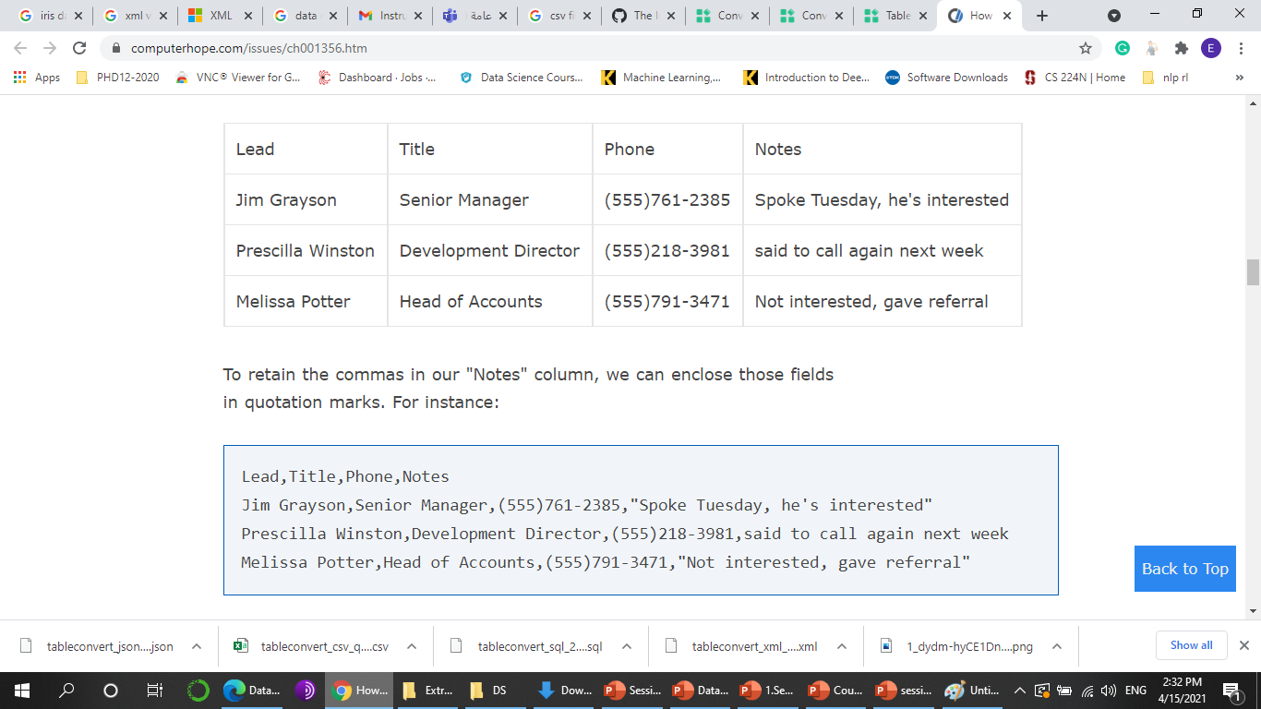
Escaping in CSV Example

Slide 21
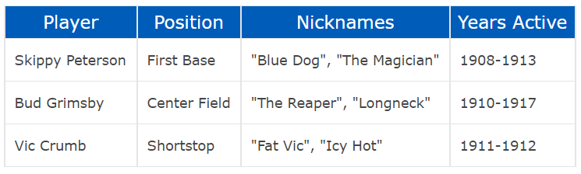
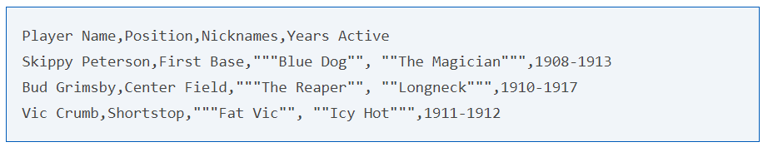
CSV Example
Here, the entire data field is enclosed in quotes, and internal quotation marks are preceded (escaped by) an additional double quote.

Slide 22
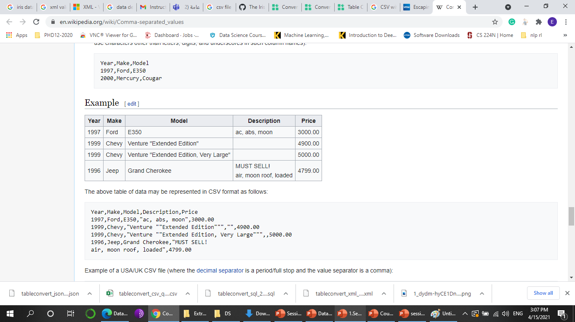
CSV Missing Value Example

Slide 23
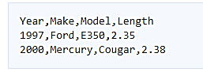

CSV Decimal Separator (. ,)

Slide 24
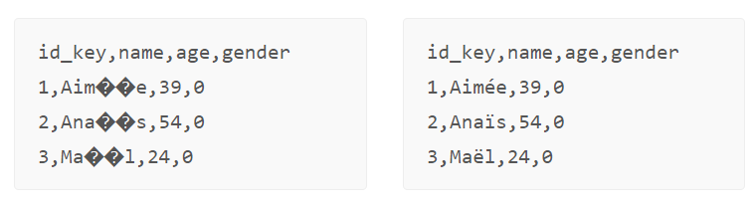
Character encoding problems in CSV Example
If you work with a non-English script, or a Latin alphabet that uses special characters, storing such text in .csv file format might lead to problems displaying it correctly.
Solution: UTF-8 encoding

Slide 25
Discover XML

Slide 26
XML
The Extensible Markup Language (XML) is a simple text-based format for representing structured data.
XML was designed to be both human- and machine-readable
XML is often used for store, carry and exchange data over the Internet.
Notes:
XML tools will not process files that contain errors

Slide 27
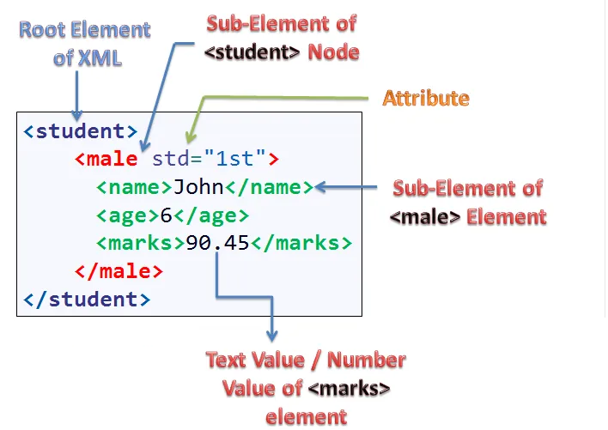
XML Terminology

Slide 28
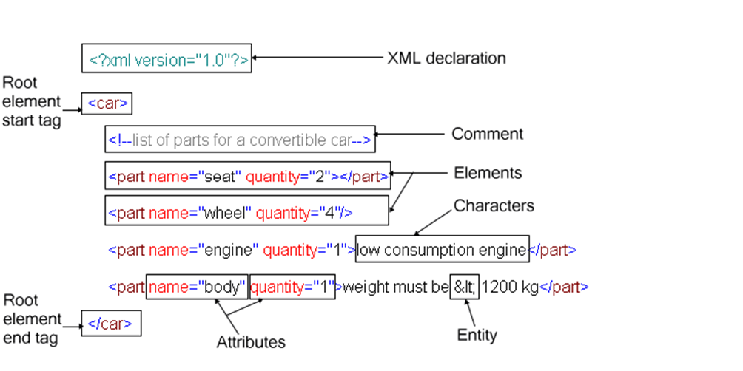
XML Terminology

Slide 29
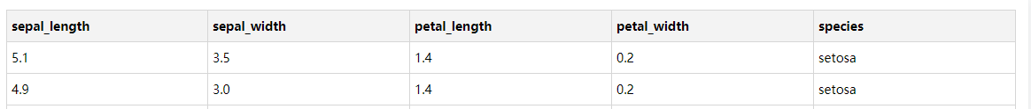
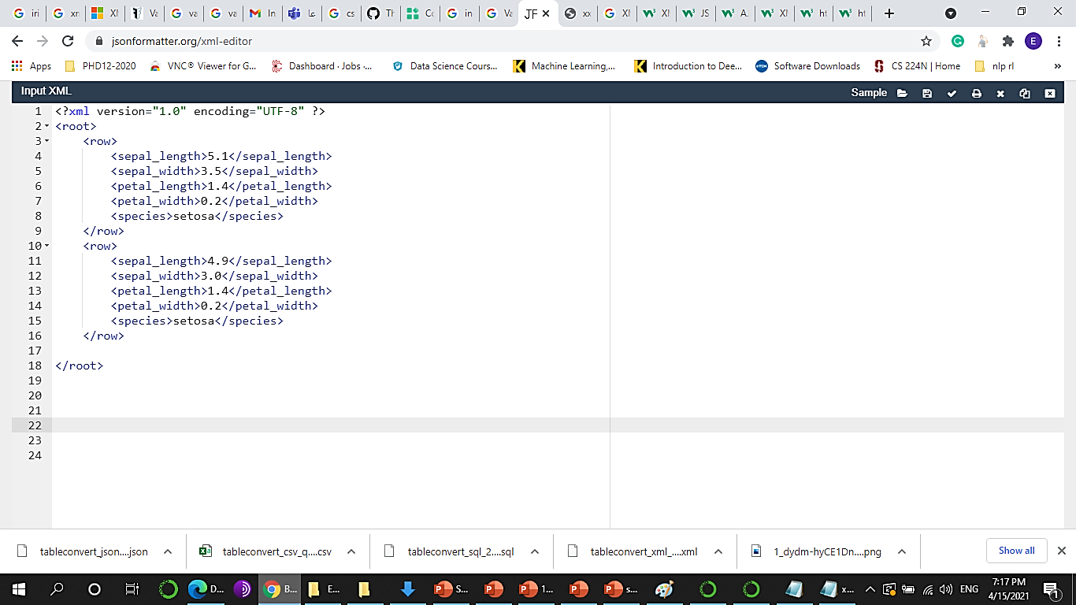
XML Example

Slide 30
XML Syntax
XML Documents Must Have one Root Element
All elements must be closed or marked as empty.
Empty elements can be closed as normal, <happiness></happiness> or you can use a special short-form, <happiness/> instead.
XML Tags are Case Sensitive
XML Elements Must be Properly Nested
XML Attribute Values Must Always be Quoted
The XML prolog does not have a closing tag.
Notes:
Demo in Case Sensitive
Demo in Missing Closing
Demo in missing root element
Comment <!-- -->

Slide 31
XML Element Naming syntax
Element names are case-sensitive.
Element names must start with a letter or underscore.
Element names cannot start with the letters xml
Element names can contain letters, digits, hyphens (-), underscores, and periods.
Element names cannot contain spaces.

Slide 32
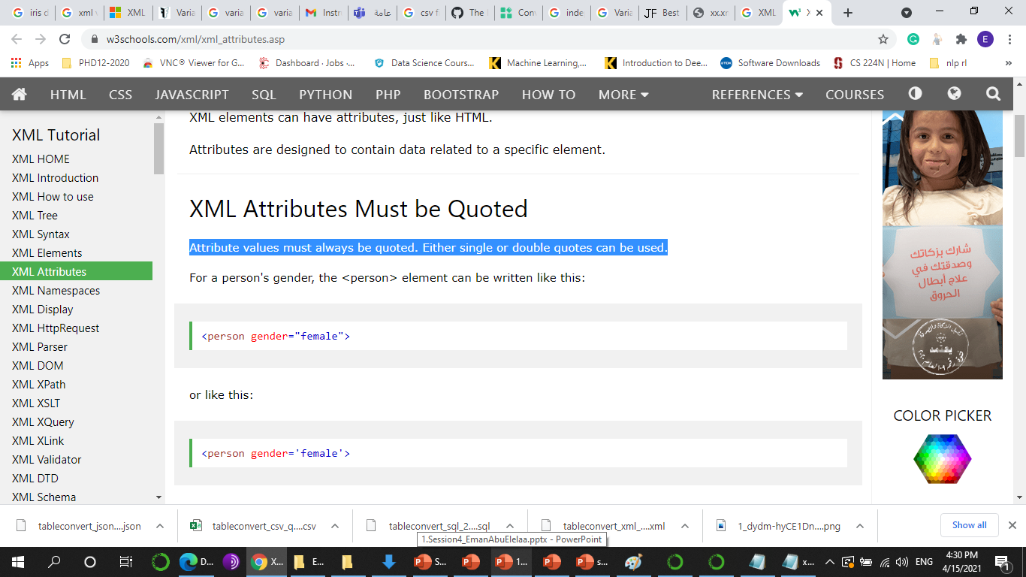
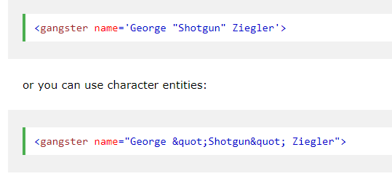
XML Attribute Naming syntax
Attribute values must always be quoted.
If the attribute value itself contains double quotes you can use single quotes, like in this example:

Slide 33
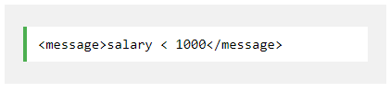
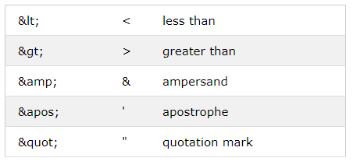
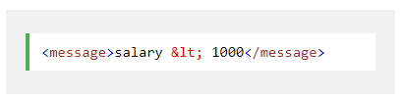
Entity References
Some characters have a special meaning in XML.

Slide 34
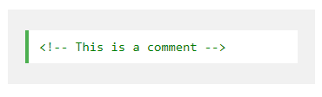
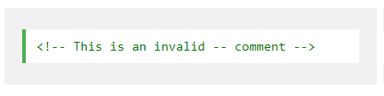
Comments in XML

Slide 35
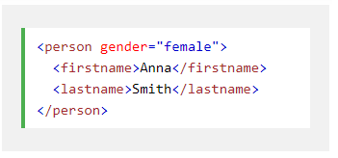
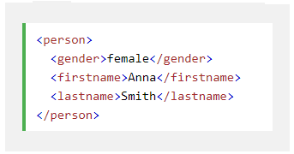
XML Elements vs. Attributes
Some things to consider when using attributes are:
attributes cannot contain multiple values (elements can)
attributes are not easily expandable (for future changes)
Notes:
In the first example, gender is an attribute. In the last example, gender is an element. Both examples provide the same information.
There are no rules about when to use attributes or when to use elements in XML.

Slide 36
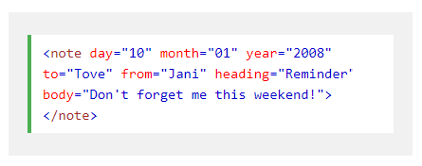
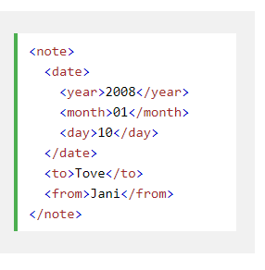
XML Elements vs. Attributes
Bad
Good

Slide 37
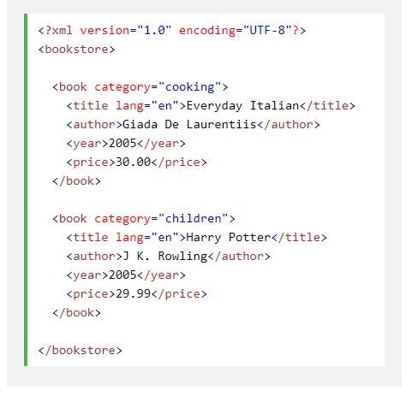
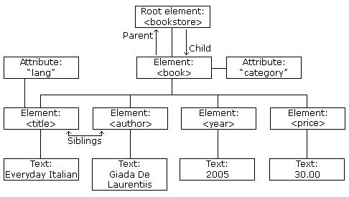
What is the DOM?
It presents an XML document as a tree-structure.

Slide 38
XML DEMO

Slide 39
Discover XSD

Slide 40
XSD
An XML Schema describes the structure of an XML document.
The XML Schema language is also referred to as XML Schema Definition (XSD).
An XML Schema is a language for expressing constraints about XML documents.
Checking a document against a Schema is known as validating against that schema.
Application1
Application2
XML
XML

Slide 41
Why Learn XML Schema?
Describe the elements and attributes that can appear in a document
the number of (and order of) child elements
It is easier to validate the correctness of data
It is easier to define data formats

Slide 42
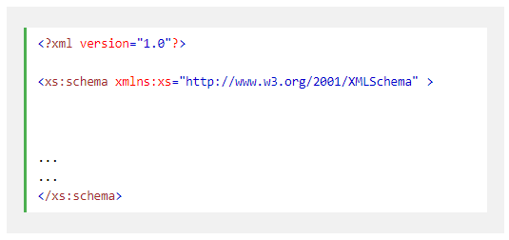
XSD Syntax

Slide 43
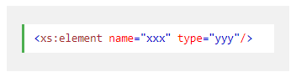
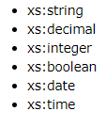
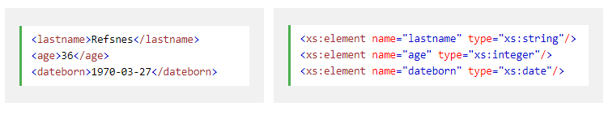
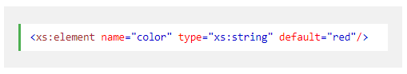
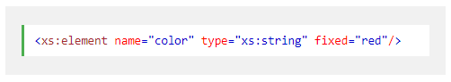
XSD Syntax : How to Define Element?

Slide 44
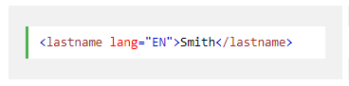
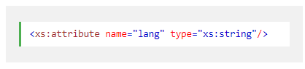
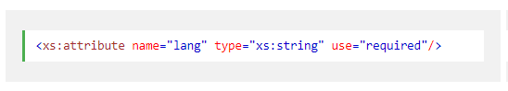
XSD Syntax :How to Define an Attribute?
Use:
Required
Optional

Slide 45
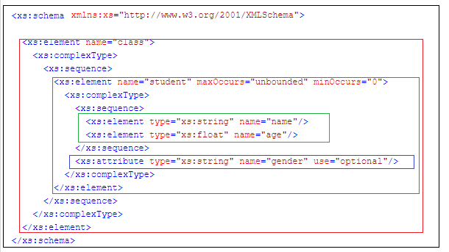
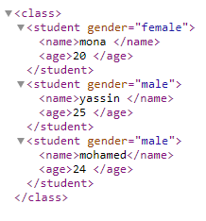
XSD Example

Slide 46
XSD DEMO

Slide 47
Discover XSLT

Slide 48
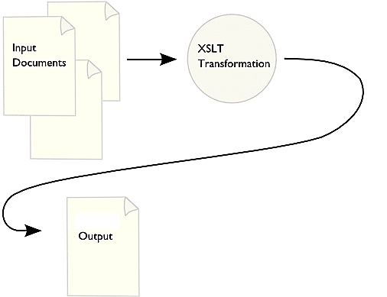
XSLT
XSL (eXtensible Stylesheet Language) is a styling language for XML.
XSL Transformations is a language for transforming XML documents into other formats ( like XML documents, CSV or HTML documents).

Slide 49
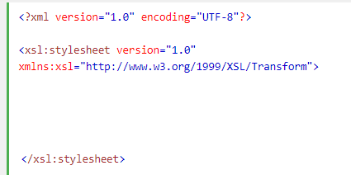
XSLT Syntax
<xsl:template match=“Xpath">
<xsl:for-each select=“Xpath">
<xsl:value-of select=“Xpath"/>

Slide 50
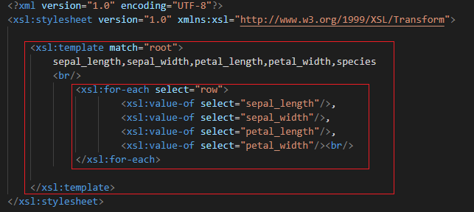
XSLT Example

Slide 51
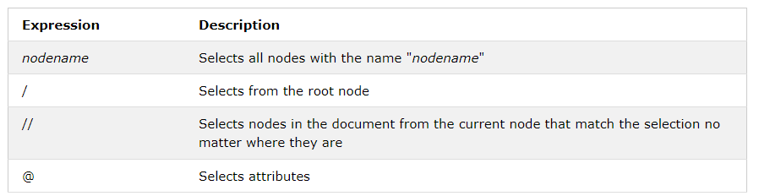
XPath
XPath is a major element in the XSLT standard.
XPath can be used to navigate through elements and attributes in an XML document.

Slide 52
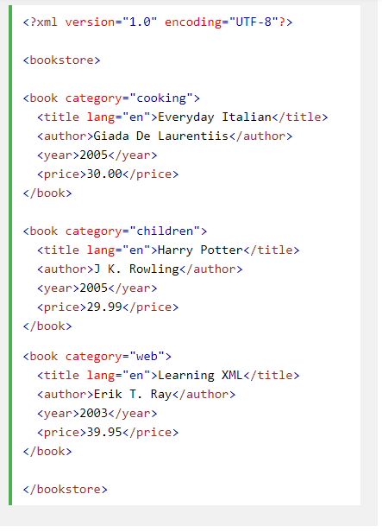
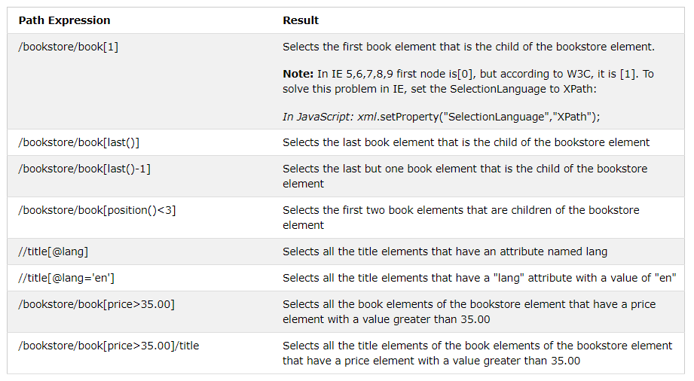
XPath Examples (w3schools.com)

Slide 53



Use XSLT to convert xml to CSV Example
Notes:
<?xml version="1.0"?> <howto> <topic id="1"> <title>Java</title> <url>http://www.rgagnon.com/topics/java-io.html</url> </topic> <topic id="2"> <title>XML</title> <url>http://www.rgagnon.com/topics/java-xml.html</url> </topic> <topic id="3"> <title>Javascript</title> <url>http://www.rgagnon.com/topics/js-language.html</url> </topic> <topic id="4"> <title>VBScript</title> <url>http://www.rgagnon.com/topics/wsh-vbs.html</url> </topic> </howto>
<?xml version="1.0"?> <xsl:stylesheet version="1.0" xmlns:xsl="http://www.w3.org/1999/XSL/Transform" xmlns:fo="http://www.w3.org/1999/XSL/Format" > <xsl:output method="text" omit-xml-declaration="yes" indent="no"/> <xsl:template match="/"> topic,title,url <xsl:for-each select="//topic"> <xsl:value-of select="@id" /> <xsl:value-of select="concat(',' , title, ',' , url,' ')"/> </xsl:for-each> </xsl:template> </xsl:stylesheet>

Slide 54
XSLT DEMO

Slide 55
Discover JSON

Slide 56
JSON
Stands for JavaScript Object Notation.
JSON is based upon JavaScript syntax.
JSON format is used for transmitting structured data over network connection.
Web services and APIs use JSON format to provide public data.
The filename extension is .json.

Slide 57

JSON Syntax
Unordered sets of Name-Value pairs
Begins with { (left brace)
Ends with } (right brace)
Each name is followed by : (colon)
Square brackets [ { }, { } ] hold arrays
Data is separated by ,

Slide 58

JSON Data Types

Slide 59
JSON vs XML
Both JSON and XML can be used to transmit data from a web server.
JSON is Like XML Because
Both JSON and XML are "self describing" (human readable)
Both JSON and XML are hierarchical (values within values)
Both JSON and XML can be parsed and used by lots of programming languages
Both JSON and XML can be fetched with an XMLHttpRequest
JSON is Unlike XML Because
JSON doesn't use end tag
JSON is shorter
JSON is quicker to read and write
JSON can use arrays
The biggest difference is that XML has to be parsed with an XML parser. JSON can be parsed by a standard JavaScript function.
For AJAX applications, JSON is faster and easier than XML.

Slide 60


JSON vs XML

Slide 61


JSON vs XML

Slide 62

Convert JSON to CSV Example
{"Product":{"0":"Desktop Computer","1":"Tablet","2":"iPhone","3":"Laptop"},"Price":{"0":700,"1":250,"2":800,"3":1200}}
import pandas as pd
df = pd.read_json (r'C:\Users\Ron\Desktop\Test\Product_List.json’)
export_csv = df.to_csv (r'C:\Users\Ron\Desktop\Test\New_Products.csv', index = None, header=True)
http://convertcsv.com/json-to-csv.htm

Slide 63
Discover ARFF

Slide 64
ARFF
ARFF (Attribute-Relation File Format) file is an ASCII text file that describes a list of instances sharing a set of attributes. ARFF files were developed by the Machine Learning Project at the Department of Computer Science.
The Attribute-Relation File Format is an ASCII text file format that is essentially a CSV file with a header that describes the meta-data.
The key difference between CSV and ARFF is in the top part of it which contains information about each of the variables.
Missing values in an ARFF data file are identified using ‘?’
A `%' at the beginning of the comment line.
Notes:
http://old-www.cms.waikato.ac.nz/ml/weka/arff.html

Slide 65


ARFF Example

Slide 66
ARFF Data types
@ATTRIBUTE vvv {0.2,30,Iris-virginica}
@ATTRIBUTE name string
@attribute order_date date
yyyy-MM-dd'T'HH:mm:ss
@ATTRIBUTE age numeric

Slide 67
ARFF
ARFF files have two distinct sections.
The first section is the Header information, which is followed the Data information.
The Header of the ARFF file contains the name of the relation, a list of the attributes (the columns in the data), and their types.
The @RELATION, @ATTRIBUTE and @DATA declarations are case insensitive.

Slide 68
Convert ARFF to CSV Example
https://pulipulichen.github.io/jieba-js/weka/arff2csv/

Slide 69


Slide 70

WorkFlow

Slide 71
Orange Data mining studio
Orange is a collection of Python-based modules that sit over the core library of C++ objects and routines that handles machine learning and data mining algorithms.
It is an open source.
Orange widgets provide a graphical users interface to Oranges data mining and machine learning methods.

Slide 72
Why use Orange ?
No programming needed - Visual programming
Data visualization
Easy to try different machine learning algorithms
Add-ons for : bioinformatics, network analysis, text mining.
Free and open source software

Slide 73

Installing for Windows
Orange Data Mining - Download

Slide 74


Load CSV File

Slide 75


Slide 76

Homework

Slide 77
Homework
Write the transformation instructions in XSLT to produce a CSV document, in order to present the following XML ?
<?xml version="1.0" encoding="UTF-8"?>
<students>
<student ID="1">
<firstName>Sandy</firstName>
<lastName>Guillaumeau</lastName>
<date>1988-04-09</date>
</student>
<student ID=“2">
<firstName>Quentin</firstName>
<lastName>Decayeux</lastName>
<date>1990-02-01</date>
</student>
</students>

Slide 78
Homework
How to represent this XML structure with a JSON format?
<?xml version="1.0" encoding="UTF-8"?>
<students>
<student ID="1">
<firstName>Sandy</firstName>
<lastName>Guillaumeau</lastName>
<date>1988-04-09</date>
</student>
<student ID=“2">
<firstName>Quentin</firstName>
<lastName>Decayeux</lastName>
<date>1990-02-01</date>
</student>
</students>

Slide 79
Homework
Define XSD schema for the following XML file?
<?xml version="1.0" encoding="UTF-8"?>
<students>
<student ID="1">
<firstName>Sandy</firstName>
<lastName>Guillaumeau</lastName>
<date>1988-04-09</date>
</student>
<student ID=“2">
<firstName>Quentin</firstName>
<lastName>Decayeux</lastName>
<date>1990-02-01</date>
</student>
</students>

Slide 80

03/01/2022
Homework

Slide 81


Notes:
https://www.youtube.com/watch?v=s9DOBPlDZ3U

